Slide 1
UNDERSTANDING POLITICAL POLLS
MSCDA 5510
PREPARED BY –
BHAGYA SHREE
NAWAZ HUSSAIN
RAVNEET OBEROI
RISHAB GUPTA
VINAY GOVINDAN
VIVEK ANAND
GROUP 6

Slide 2
What is a random sample? How would you go about collecting one? What factors must you consider when designing a sample frame?
A sample of a given population where each individual has an equal chance of being selected.
Collecting Sample :Randomly selected subset of people who are eligible for voting(2638)
Choose sample size based on acceptable values confidence level and margin of error.
Construct list of target population.
Assign numbers to each individual.
Find random numbers
Select your sample .
We will design our sample frame on these factors:
People who have eligible for voting
People who resides in canada
Region
Age

Slide 3
The case says that 38% will vote Liberal. Is this a fact or an estimate?
From the sample that we collected, we have estimated that 38% of the people will vote for the Liberals.
38% is proportion
38% is the unbiased point estimate of the population proportion that are inclined to vote liberal

Slide 4
The case says that the survey is accurate within 1.9% points. What exactly does this mean?
1.9% is the our Margin of Error in this case.
It means that our statistic will be within 1.9% points of the whole population 95% of the times.
38% - 1.9% < LIBERALS < 38% + 1.9%
26% - 1.9% < CONSERVATIVES < 26% + 1.9%
i.e if we take 100 samples of size 2648 from the population, the proportion of times the mean would lie within the confidence interval would be 95 %.

Slide 5
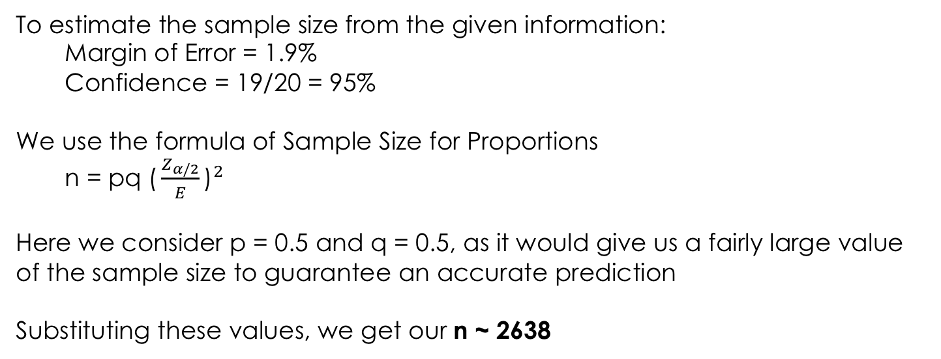
The case says that the sample consisted of 2,638 people. Where did this number come from?
To estimate the sample size from the given information:
Margin of Error = 1.9%
Confidence = 19/20 = 95%
We use the formula of Sample Size for Proportions
n = pq ${\text{(}\frac{Z_{α/2}}{E}\text{)}}^{2}$
Here we consider p = 0.5 and q = 0.5, as it would give us a fairly large value of the sample size to guarantee an accurate prediction
Substituting these values, we get our n ~ 2638

Slide 6
The case also says the results are accurate 19 times out of 20. What does this mean?
By the accuracy of 19 out 20 times, we mean that 19/20 = 0.95, that our statistics would fall under the aforementioned range 95% of the times.
or
I am 95% confident that my estimates fall under that proportion.

Slide 7
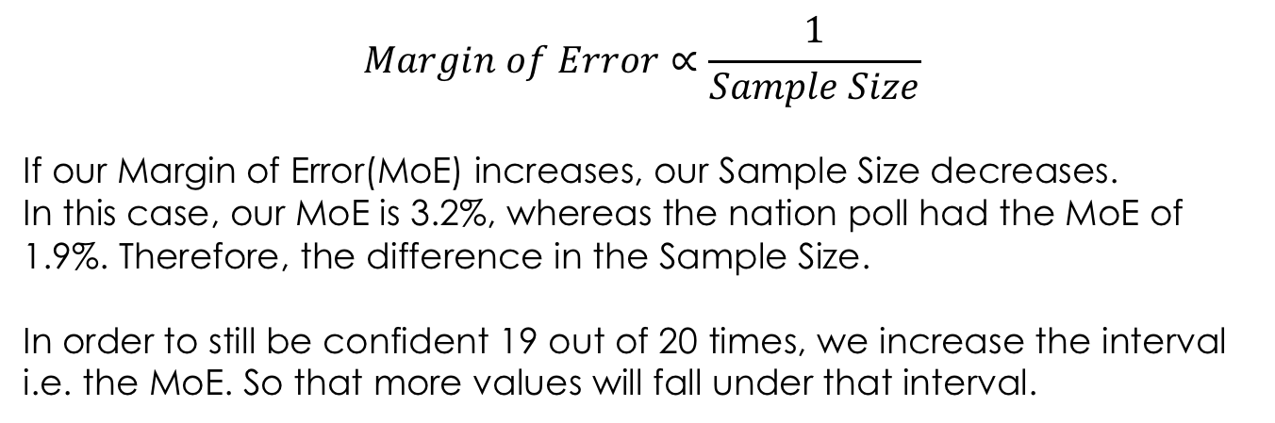
The Ontario poll has 940 people whereas the nation poll had 2,638 people. Why this difference? How does the smaller sample size affect the results? How can they still be confident the poll is right 19 times out of 20?
$$Margin of Error∝\frac{1}{Sample Size}$$
If our Margin of Error(MoE) increases, our Sample Size decreases.
In this case, our MoE is 3.2%, whereas the nation poll had the MoE of 1.9%. Therefore, the difference in the Sample Size.
In order to still be confident 19 out of 20 times, we increase the interval i.e. the MoE. So that more values will fall under that interval.

Slide 8

The journalist said that support drops off dramatically after age 65. Do you agree with this statement? If not, why is he wrong?
Assuming the Margin of error for each group is same as that of the sample +_3.2 , confidence level 95%
By substituting value in
Confidence Interval for 50-64 = [40 -3.2] < mean< [40+3.2]
36.8 < mean < 43.2
Confidence Interval for > 65 = [34-3.2] < mean < [34 +3.2]
30.8 < mean< 37.2
CI is overlapping, for two age group
Thus we cannot conclude that support drops off with 95% confidence level ,

